Slide 1
CSYE 7374
Design Patterns
Notes:
1.001

Slide 2
Adapter Design Pattern
Daniel Peters
d.peters@neu.edu

Slide 3
Lecture
UML
Design Patterns:
Gang of Four (GoF)
Adapter Pattern

Slide 4
Relationships
5/21/2020
Association
Aggregation
“Has-A”
Composition
“Has-A”
Generalization
Inheritance
“Is-A”

Slide 5
Association Relationship
5/21/2020
Association: Has-A Relationship
Aggregation
Weak association: linked but independent objects
possessed object can survive after possessing object
Line with open arrowhead outline
Composition
Strong association: linked objects are dependent
possessed object is destroyed along with possessing object
Line with solid filled-in arrowhead

Slide 6
Aggregation Association Relationship
1..*
1
10..*
1
1
1
6/12/2020
Weak Independent Aggregation Association
Teacher Classroom
Student School
Driver Automobile
Teachers can continue to exist without Classroom
Student existence independent of School
Driver can get another Automobile

Slide 7
Composition Association Relationship
2
1
1
1
1
1
6/12/2020
Strong Dependent Composition Association
Eyes Body
State Context
AutoState Automobile
The Automobile State (AutoState) is dependent on existence of the Automobile

Slide 8
Relationships
9/7/2015
Generalization
Parent
Child

Slide 9
UML Class Diagram
Class
Attributes
Operations
9/7/2015

Slide 10
UML Class Diagram
ClassName
- private
- Attribute1 : int
- Attribute2 : String
+ public
+ Operation1() : int
+ Operation2(int) : void
9/7/2015

Slide 11
Shape Class Diagram
Shape
- size : int
- name : String
+ getArea() : int
+ getSize() : int
+ getName() : String
+ setName(String) : void
Circle
Square
- radius: double
- length : int
+ getRadius() : int
+ setRadius(int) : void
+ getCircumference() : int
+ getLength() : int
+ setLength(int) : void
2/22/2020

Slide 12
Design Patterns
Gang of Four (GoF) Book
Design Patterns
Elements of Reusable Object-Oriented Software
by Erich Gamma, Richard Helm, Ralph Johnson John Vlissides
ISBN-10: 0201633612
ISBN-13: 9780201633610

Slide 13
Structural Design Patterns
Class Object relationships and interaction
How classes and objects are composed to form larger structures
Use Inheritance
Make independently developed class libraries work together
Gang of Four (GoF) Book

Slide 14
Structural Design Patterns
Describes ways to compose objects to realize new functionality
Changing object composition at run-time is a flexibility impossible with static class composition
Gang of Four (GoF) Book

Slide 15
Adapter Design Pattern
Adapter Pattern is a Structural Pattern in GoF Design Patterns Book:
“ Convert the interface of a class to another interface a clients expect. "
Adapter: also known as Wrapper
Allows reuse of a toolkit class despite domain-specific interface mismatch
Structural Pattern for an interface converter
Allows re-use adapting incompatible interface

Slide 16
Adapter Design Pattern
Anatomy of a Design Pattern
Who (are): Constituent Components (parts)
What (happens): Operational
Where (useful): Scenarios
Why (design) Rationale
When (used): Benefits

Slide 17
Adapter Design Pattern
Who:
Constituent components, roles or parts participating in the deployment and use of the Adapter pattern
Client package or tooling
Client API
All tooling plug-ins must implement Client API
Non-client Legacy code and it’s API
Adapter Implementation
Conforms to third party Client API
Adapts Client API to Legacy API

Slide 18
Adapter Design Pattern
What:
A brief description of what happens with the use of the Adapter pattern
Client uses Adapter normally via Client API
Client unaware of Legacy code or it's API
Adapter uses Legacy code via Legacy API
Services Client API by using Legacy API
Provides Inter-operability while maintaining loose coupling

Slide 19
Adapter Design Pattern
Where:
A list of suitable scenarios for the use of the Adapter pattern
In a Loosely coupled system where (1 or more of the following):
Software with incompatible APIs must interoperate
Legacy code must be leveraged without changes
New tool must use the previous tools customized extensions

Slide 20
Adapter Design Pattern
Why:
A brief description of rationale behind the design of the Adapter pattern
Adapter uses
Object composition: HAS-A object of API to be adapted (Legacy code using Legacy API)
Class subclassing: IS-A derived class of Client API
Adapter is Go Between and Translator of differences between Client API and Legacy API to be adapted
Adapter MUST use BOTH APIs

Slide 21
Adapter Design Pattern
When:
A brief description of the benefits obtained when using the Adapter pattern
Abstraction: Adapter hides use of adapted (Legacy API) code
Interoperability: allows use of incompatible APIs
Inter-operability achieved while maintaining loose coupling
All code changes are contained in Adapter
No changes to either Client nor Legacy code

Slide 22
Adapter Pattern
2/15/2022
Adapts a given client interface to work with a pre-existing third-party Legacy interface.
Third-party Legacy interface remains unchanged and Legacy code is used AS-IS
Adapter Is-A implementation of client interface
Adapter implementation performs all work to use and “Adapt” to third-party Legacy interface for (on behalf of and while complying with) the client interface

Slide 23
Adapter Pattern
5/22/2020
Re-use and existing class but interface incompatibility exists;
Adapter is a smart “go-between”
Client uses Adapter
Adapter uses existing incompatible Third-Party Legacy application on behalf of the Client
Adapter Logic makes everything work
Invisible to Client

Slide 24
Adapter Pattern Versions
9/7/2015
Two Adapter designs
Class Adapter
Object Adapter

Slide 25
Class Adapter Pattern
9/7/2015
Adapter employs multiple inheritance
Adapter inherits Client Interface AND ALSO Third-Party Interface

Slide 26
Object Adapter Pattern
9/7/2015
Adapter implements Client Interface
Adapter has an instance (composes a Third-Party instance which it is adapting)

Slide 27
Class Adapter Class Diagram
Client API
Third-Party API
Class Adapter
2/22/2020

Slide 28
Object Adapter Class Diagram
Client
Client API
Third-Party Class
Adapter
9/7/2015

Slide 29
CalculatorAdapter Class Diagram
POSClient
AccumulatableAPI
+ accumulation(List): double
+ payment(double): double
CalculatableAPI
CalculatorAdapter
+ accumulation(List): double
+ payment(double): double
2/15/2022

Slide 30
Third Party Application Class Diagram
CalculatableAPI
+ operation() : double
Calculator
+ operation() : double
5/21/2020

Slide 31
Client Interface
public interface AccumulatableAPI {
double accumulation(List<Double> itemPrices);
double payment(double payment);
}
Client Point of Sales Register application
Required Client API
AccumulatableAPI

Slide 32
Third Party Interface
public interface CalculatableAPI {
public enum OPERATION {ADD, SUB, MULT, DIV}
double operation(OPERATION op, double a, double b);
}
Third Party Calculator application
Pre-existing API
CalculatableAPI
Calculator

Slide 33
CalculatorAdapter
public class CalculatorAdapter implements AccumulatableAPI {
private final Calculatable calculator;
private double sum;
. . .
}

Slide 34
CalculatorAdapter
public class CalculatorAdapter
implements AccumulatableAPI {
public CalculatorAdapter(Calculatable calc){
super();
this.calc = calc; // 3rd Party App
this.sum = 0;
}
. . .
}

Slide 35
CalculatorAdapter
public class CalculatorAdapter
implements AccumulatableAPI {
. . .
@Override
public double accumulation (List<double> prices) {
sum = 0;
for (double itemPrice : prices) {
sum+= this.calc.operation(OPERATION.ADD,
sum, itemPrice);
}
return sum
}
. . .
}

Slide 36
CalculatorAdapter
public class CalculatorAdapter
implements AccumulatableAPI {
@Override
public double payment (double cash) {
return this.calc.operation(OPERATION.SUB,
cash, sum);
}
. . .
}

Slide 37
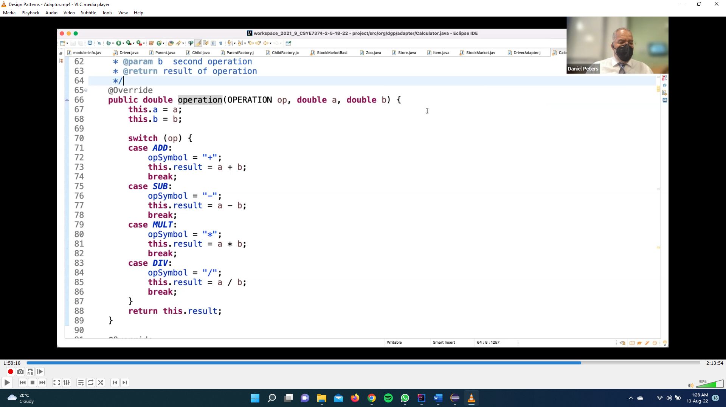

Slide 38
Summary: Adapter Pattern
Adapter Pattern: Interface Converter
Structural Pattern

